Slide 1
WOMEN AND LAND IN ZIMBABWE

Slide 2
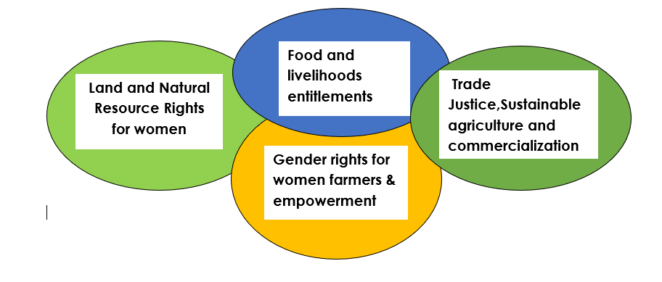
ABOUT WOMEN AND LAND (WLZ)
Women and Land in Zimbabwe (WLZ) is a membership-based local non governmental organization- operating in 14 rural districts in the country
Our Pillars:

Slide 3
Conti.
WLZ’s mandate is to economically empower rural women through supporting women’s agro- and non-agro based activities
And to also respond to climate change shocks through rebuilding rural women’s livelihoods and building their resilience
Our work focuses on building of platforms for social & economic dialogue on women’s land rights, promotion of sustainable agriculture production, movement building and access to markets to support full economic empowerment of women and youths in Zimbabwe.
Some of our interventions include climate change awareness and copying innovations to reduce the adverse effects of climate change for example through promotion of sustainable low-cost solar powered irrigation farming and adoption of water harvesting techniques for rural women.

Slide 4
What are smallholder farmers’ biggest challenges, even beyond tech?
Weak tenure system- which is not bankable not promoting agric development in rural areas resulting in limited financial support for land based investments,
access to inputs and markets distortion’s – producer prices are not taking into consideration what went into actual production and failing to take farmers back into the field,
climate crisis has become a big monster to small holder farmers most of whom depends on rain fed agriculture- poor rainfall patterns, droughts, floods [the distributions of rains is not long enough to see crops through to maturity],
limited access to technology including digital technology due to limited resources, culture and poor network coverage- eg use of whatsapp and other social media platforms for marketing and e-learning not possible in some rural areas due to poor network connectivity, growing of some crops not is sinc with some cultures and use of fuel powered machinery not allowed due to cultural reasons

Slide 5
What have we learned in the field about tech solutions?
- that technology is the way to go if we want to reduce farming costs and adapt to climate change [to ensure that our crops reaches maturity stages].
-Technology [digital] is assisting some farmers to reach out to good markets, information and learning
other technologies such as solar powered irrigation infrastructure –adaptation to climate
- Africa still lagging[ cultural and financial reasons] behind in terms of use of technologies-there is need to continue looking for more resources and do a lot of awareness raising for communities to embrace technology

Slide 6
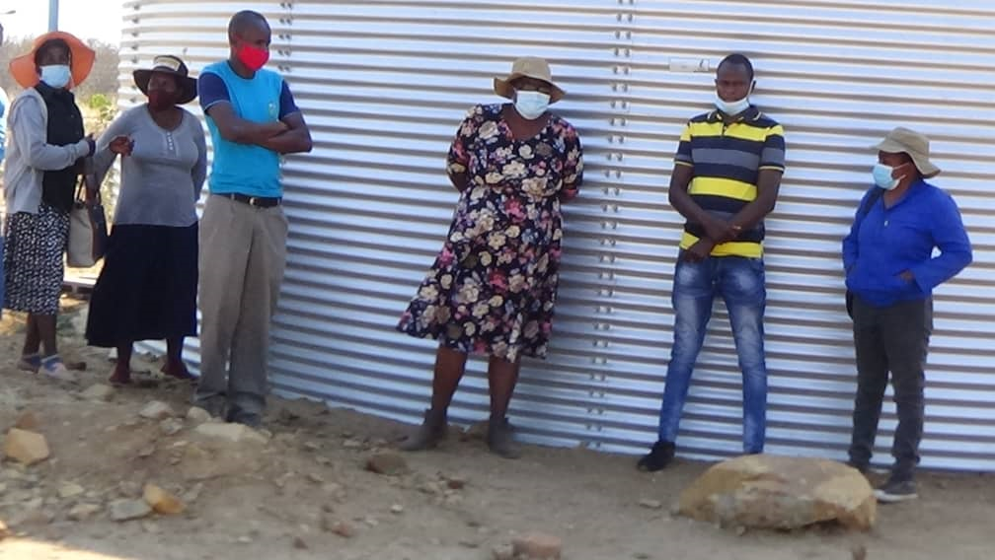
OUR WORK IN PICTURES One of our Irrigation schemes ( solar panels and reservoir tanks )

Slide 7
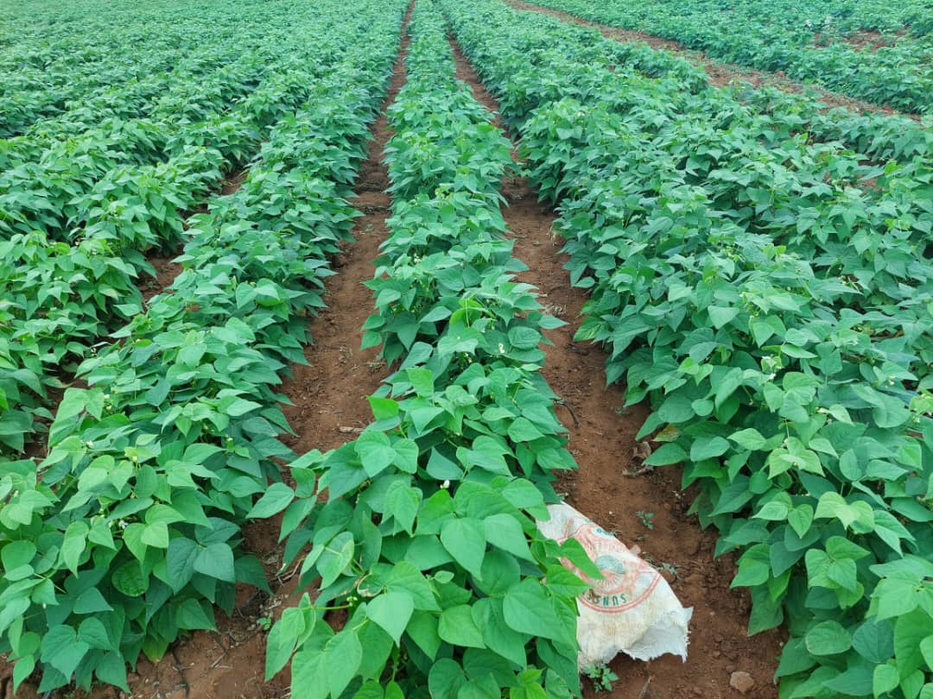
Some of our crops from the Schemes

Slide 8
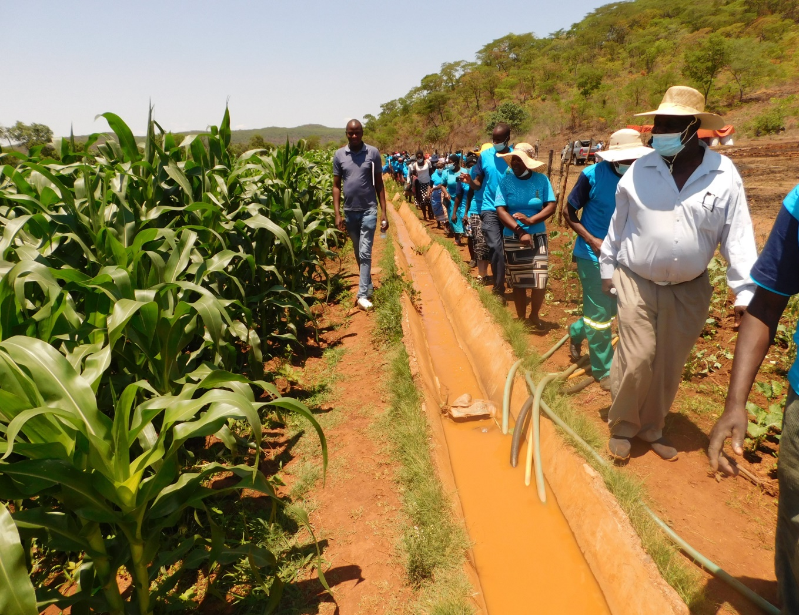
maize crop -Irrigated through canals

Slide 9
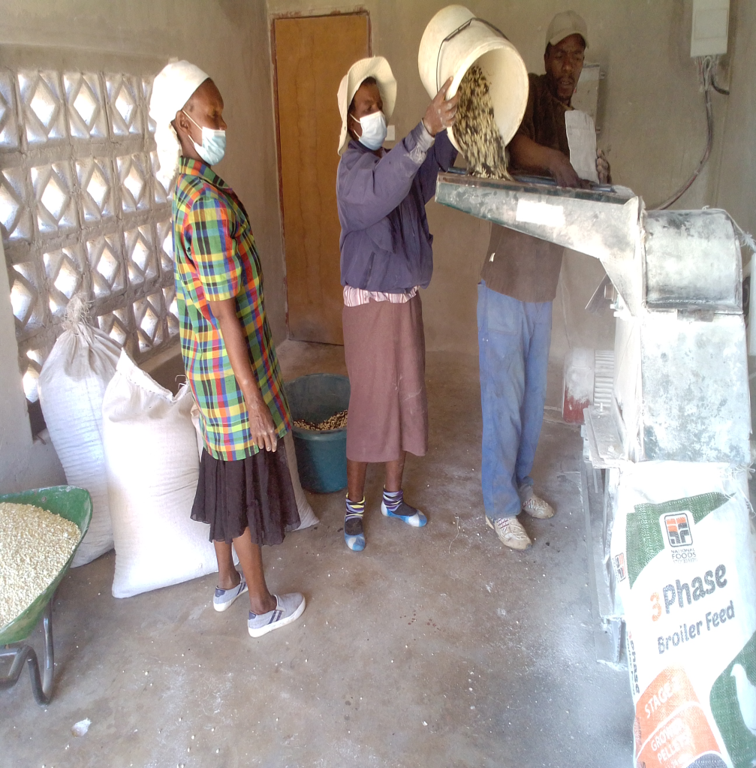
Processing and Value Addition machinery:

Slide 10
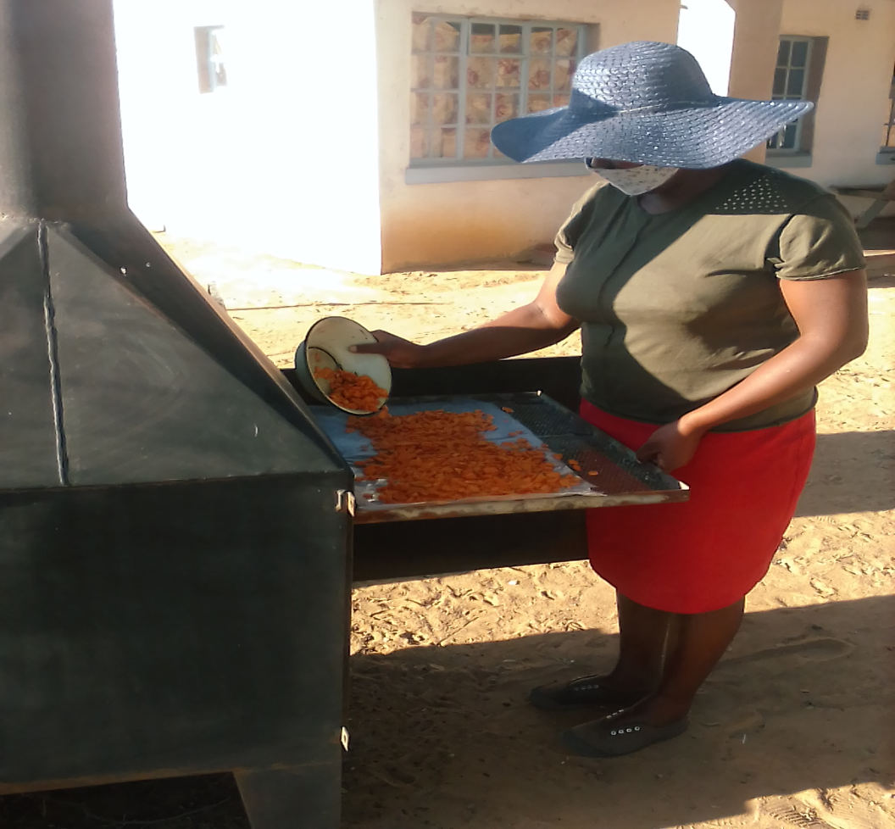
Left (Oil processing) Right (Solar Drying of vegetables)

Slide 11
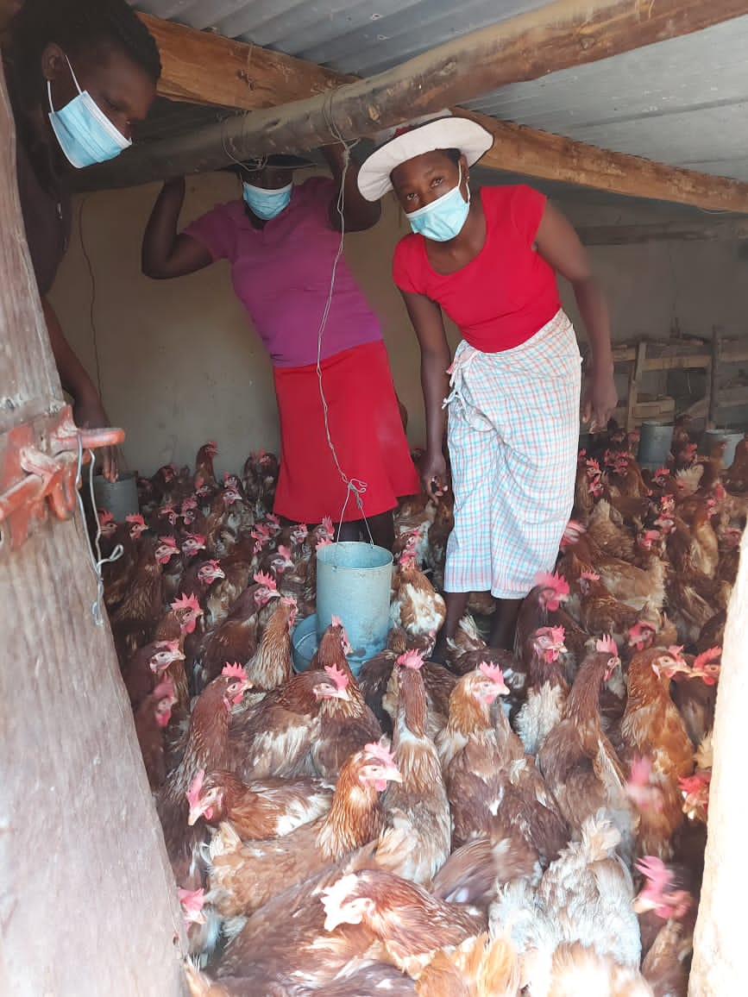
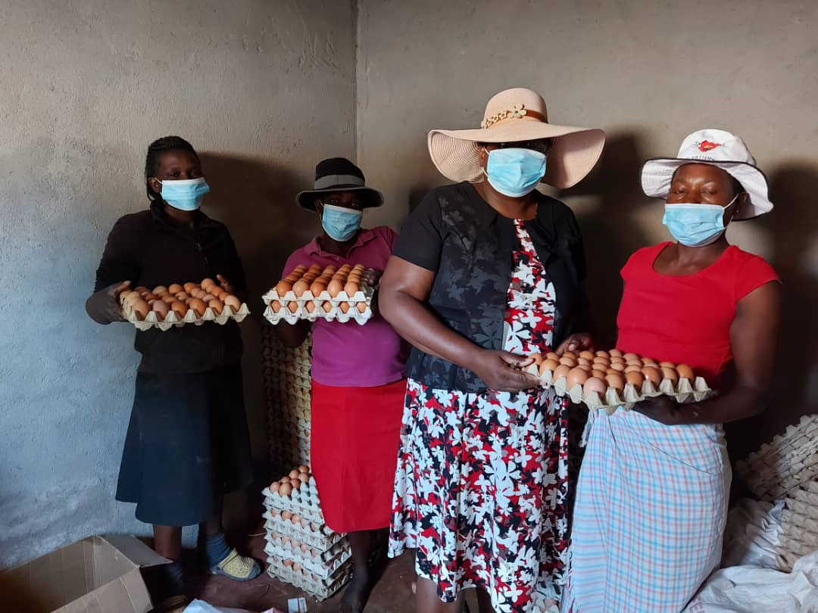
Support of fish and poultry projects

Slide 12
How do we best engage and prioritize women farmers/entrepreneurs?
We need to have deliberate strategies to support women to embrace technology- need to invest more in trainings for women on use of technology including digital technology for the whole agric value chain
Come up with financial packages/ funding mechanisms targeting and developing women’s productivity in Agric

Slide 13
What should we consider and prioritize in the future?
-Partnership with private sector especially those into telecoms for network coverage in rural areas- lobby for affordable data packages
-building rural women’s resilience to adapt to the effect of climate change- this can be in form of funding low cost solar powered irrigation infrastructure, promotion of the growing of introduction of drought resistant, nutritious crops and adoption of technology
-Improve women’s financial inclusion- women’s access to financial resources, promotion of ISALs
-Improving women’s access to land and related resources and improving tenure system for women

Slide 14
Thank You!

