Slide 1
Jonathan Lehe
Chief of Strategy, Partnerships, and Innovation
Precision Development (PxD)
PxD Pakistan:
Mobile-Based Farmer Engagement on Nutrition-Smart Agriculture
September 13, 2022

Slide 2
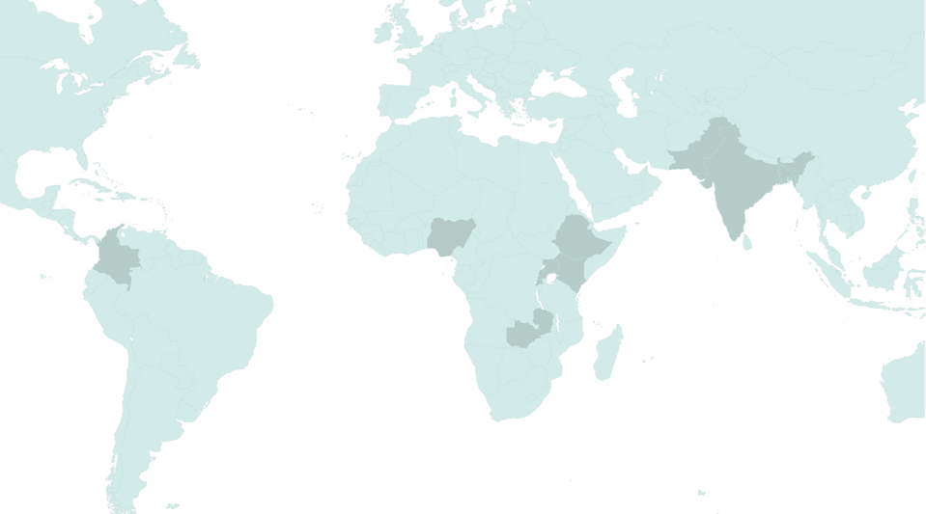
PxD at a Glance
Global non-profit organization serving more than 7M users in nine countries in Africa, Asia, and Latin America
Mission: We provide actionable information and other scalable services to people in poverty to empower them to sustainably improve their well-being
Vision: An end to information poverty

Slide 3
Digital Agricultural Advisory Services Using SMS & Voice
Key Features:
Low tech (simple phones)
Customized
Available on demand
Timed to crop calendar
Low cost (<$2/farmer/year)
Free to the user
Human-centered design
Continuous iteration

Slide 4
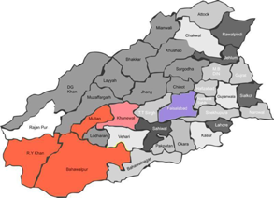
PxD-HarvestPlus Partnership in Pakistan (2020-21)
Purpose
Beneficiaries
Intervention
To increase adoption of two zinc-biofortified wheat varieties in Pakistan (Akbar-19 and Zincol-16) to complement PxD’s standard wheat advisory service
~103,000 smallholder wheat farmers in 5 districts of Punjab province, Pakistan with an average land size of ~4 acres
SMS and Voice messages in Urdu and Saraiki highlighting the benefits of zinc-biofortified seeds:
Nutritional benefits (reduced zinc deficiency, stunting, pregnancy complications, diarrhea, malaria, pneumonia, etc.)
Higher yields
Crop disease resistance (e.g. rust)

Slide 5
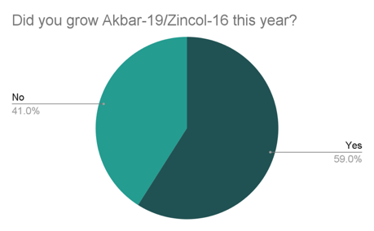
PxD-HarvestPlus Partnership in Pakistan (2020-21)
Key Results:
59% of farmers surveyed used zinc-biofortified seeds in 2020-21, an increase from only 9% the previous season
We cannot interpret this as causal impact due to other factors (e.g. supply increase), but these results are promising
Additional research needed to measure impact on health, yield, and income
Challenge reaching female farmers
Issues around seed availability and price variability
Potential to scale this to ~6m wheat farmers in Pakistan, and beyond

Slide 6
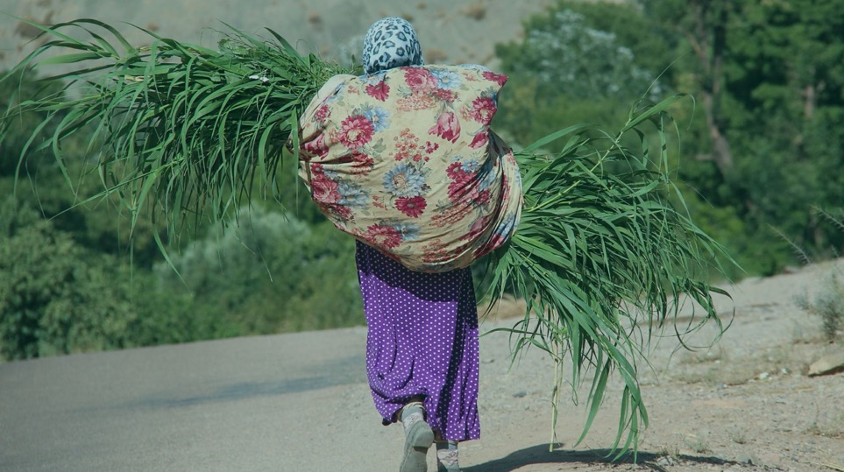
Empowering users with quality information at their fingertips.
www.precisiondev.org
Twitter: PrecisionXDev

