Slide 1
BiofortX Mobile Solution
Strengthening Nutrition-Smart Agriculture for a Healthy Africa

Slide 2
Platform Overview
connect actors in the biofortified supply chain to bridge market and information gaps
facilitate and encourage growth of Vitamin A Maize (VAM) and Vitamin A Cassava (VAC) value chains;
stimulate digitalization strategy to improve transparency, efficiency, competitiveness and sustainability of VAC/VAM food crop in Nigeria;
support VAC/VAM production as part of the strategy to improve transparency, efficiency, competitiveness and sustainability of the agrifood sector in Nigeria.
Notes:
What is the project about?
Define the goal of this project
Is it similar to projects in the past or is it a new effort?
Define the scope of this project
Is it an independent project or is it related to other projects?
* Note that this slide is not necessary for weekly status meetings

Slide 3
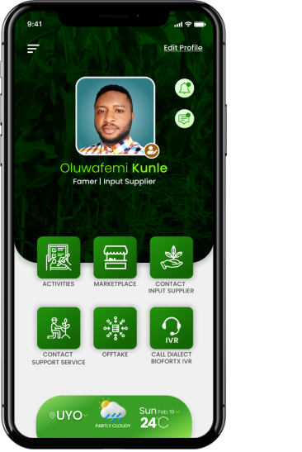
Functionalities
Activities
Contact Support Service
Support farmers with production and yield information
Connect farmers with approved Support Service Provider for ease access to Good Agronomic management Information for biofortified crops
Marketplace
08021810028
Create market linkage to facilitate biofortified trade relationship between farmers and external market through e-commerce channel
Offtake
•Supports Bulk purchase of biofortified products from farmers
Contact Input Supplier
Call Dialect BiofortX IVR
Connect farmers with approved input providers for ease access to inputs and biofortified seeds/seedlings
Provide rural farmers with alternative connect ion

Slide 4
How it Works
Input Suppliers
Farmers
Support Service Providers
Food Processors and Manufacturers
Register/Login (or Call IVR Number for Rural Services
Use Activities to monitor crop production
Request & Access service providers
Request & Access Support Service
Buy and Sell on BiofortX Market Place
Register/Login
Match Services to Farmer’s Request
Get Paid for Service Provided
Post Input for display on Marketplace
Register/Login
Match Services to Farmer’s Request
Get Paid for Service Provided
Earn Rating from Farmers
Register/Login
Order/Aggregate bulk products from BiofortX
Make payment
Order Delivered

Slide 5
BiofortX local dialect IVR connect rural farmers to service providers and market using GSM Gateway. With this in place, a rural farmer can call a PBX system the same way she would call another person’s mobile phone.

Slide 6
BiofortX is Available and is Downloaded at https://biofortx.com/
….and Proudly sponsored and funded by
BiofortX is Designed and Developed by
EL-kanis and Partners is a Food Production and Tech-based Agricultural Support Service Company.
Contact: 1 Enen Afaha Street, Uyo, Akwa Ibom State. Nigeria
Phone: 08027331036
Email: info@elkanisgroup.com
Website: www.elkanisgroup.com
HarvestPlus improves nutrition and public health by developing and promoting biofortified food crops that are rich in vitamins and minerals, and providing global leadership on biofortification evidence and technology.
https://www.harvestplus.org/

