Slide 2
IFFCO - Extensive Reach And Strength In Rural India
svfsdf
Additional Services through JVs/Partnerships
IFFCO is a household name in rural India that generations of Indian farmers have put their trust in for over 50 years
IFFCO is present in almost every district, taluka and tehsil of India and reaches 55 Million farmers (45% of India’s farming population) through 35000+ PACS as member societies
IFFCO Kisan
IFFCO Tokio
IPL
NCDEX
IKSEZ
IKBLL
IFFCO MC
IFFCO E-BAZAR
SIKKIM IFFCO ORGANICS LTD
AQUAGRI PROCESSING PVT. LTD
CORDET
IFFDC
Brand & Recognition
Distribution & Reach
IFFCO
Financial Strength
Expertise & Infrastructure
IFFCO produces and distributes nearly one-third of the fertilizer consumed in India with an annual turnover of USD 4B
IFFCO’s expertise and infrastructure in rural India is unmatched, making it the ideal partner for entering rural markets

Slide 3
IFFCO Kisan Agri-Tech Ecosystem
Farm Advisory Services
Technology Stack
IFFCO Kisan Agriculture app
Precision farm Stack - Krishi Dev Gyan
IFFCO Kisan Urban Greens
Green SIM / SAMADHAN Services
IFFCO Kisan Helpline
Kisan Call Centre
Backward Linkage
Market Linkage
Leverage ICT to reach larger rural population at ease, engage them with timely and actionable advisories, empowering them to take informed and improved decisions
Improve existing agri-value chain through ‘FPO based procurement model’ / market linkages. Bridge the gap between farmers and agri-processing industry
Animal Husbandry
Field / Aggregation Services
Compound cattle – feed
Animal care services
CBBO - Promoting Farmers Clubs & FPOs
Farmer Forward Linkage Program

Slide 4
450,00,00+ farmers
30,000+ acres
3,00,000+ acres
Engaged farmers through farm advisories
100,00,00+ farmers
Engaged farmers on the app
Model farms connected with virtual IoT and remote sensing data points
Drone Sprays

Slide 5
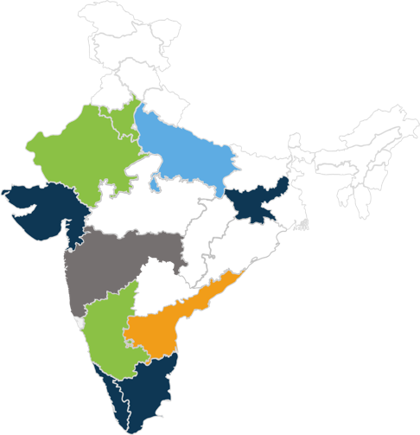
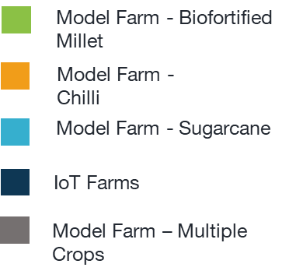
Activity Map with Similar Interventions
Major Crops | Area of Operation
Millet, Paddy, Wheat | UP, Haryana, Rajasthan, Madhya Pradesh, Karnataka, Maharashtra
Tomato, Onion, Papaya, Mango and Other Fruits | Maharashtra, Gujarat, Madhya Pradesh
Chilli, Turmeric, Ginger, Cumin, Cardamom, Coriander | Andhra Pradesh, Telangana, Odisha, Kerala, Karnataka, Rajasthan, Gujarat
5

Slide 6
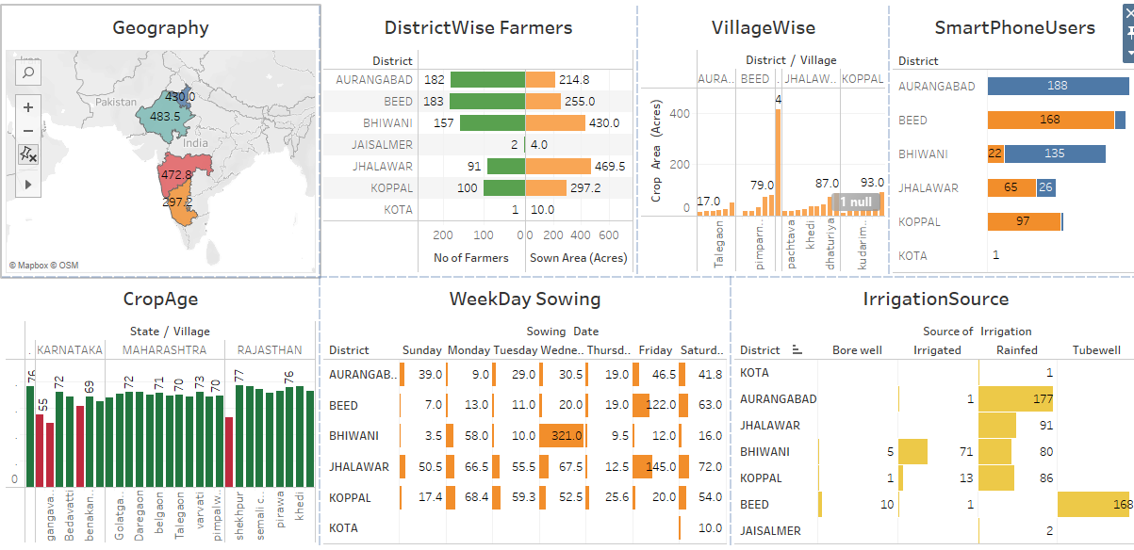
Overview – CBC Program IFFCO Kisan
Click to view map: CBC_2022 | Tableau Public

Slide 7
Benefits to Stakeholders
Farmer
Agribusiness/ FPO
Partner
- Technology orientation and capacity building on Biofortified crops
- Near-real time farm advisory services (voice and SMS)
- On-ground agri-expert support on weekly basis
- Pest & disease guide book, leaf color chart
- Weekly remote sensing based analytics on farm performance
- Training on utilizing cutting-edge precision farming technology
- Set up ‘island of excellence’ with precision tech in vicinity
- IoT sensors: 4 AWWSs installed
- ‘demand-driven’ crop production under holistic contract farming arrangement
- Turn-key services offering complete tech enabled end-to-end implementation services
- Impact driven last mile farmer connectivity and engagement
- Possibility of scaling up commercial programs through a single ecosystem
7

Slide 8
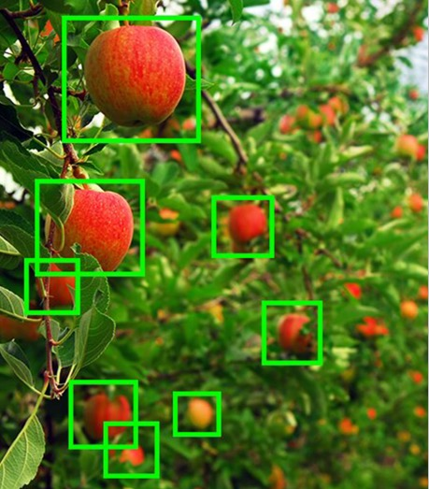
Tech Overview
Farm traceability – Digitized farm profile, geo-fencing, sowing date, age of crop, yield, inputs used, irrigation time, soil report
Satellite imagery analysis – Weekly NDVI (growth of crop), soil moisture stress, Nitrogen spread, soil organic carbon content
Image recognition – Auto image based disease and pest recognition
Crop simulation models – Simulate farm conditions in advance to predict pest and disease infestation, schedule irrigation, fertigation
IoT Sensors – Dynamic farm microclimate (6 IoT sensors for: Soil moisture (above and under soil), leaf moisture, temperature, radiance, humidity)
8

Slide 9
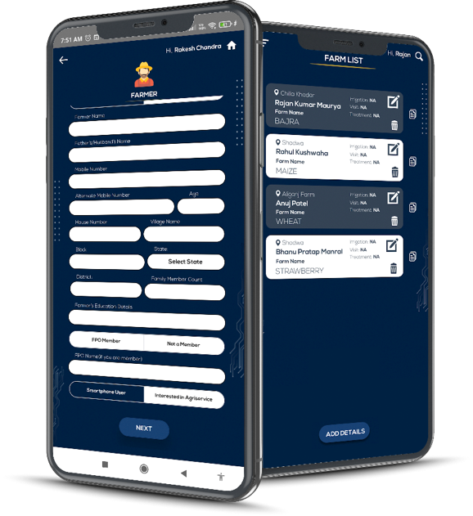
Krishi Dev Gyan
(Go Live)
Advisories on cutting edge and current Agri-research based crop PoPs.
Near real-time consultation with top-notch Agri-experts via video and audio channels.
Satellite Imagery Analysis
Pest and Disease prediction based on weather conditions
Data-driven authorized automated personalized advisories
KDG App is used by all the Field Executives to onboard farmer details and farm data to capture daily activities.
9

Slide 10
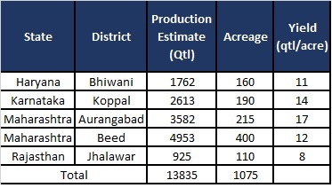
Results and Potential to Scale
Ongoing season projections – Kharif Pearl Millet
Future Potential
Immediate potential in upcoming Rabi season for Biofortified Wheat – 20k acres
May further scale to 50k acres
May look at expanding to key geographies – UP, MP, Bihar,
10

Slide 11
Key Lessons
Lack of digital-twin of farms prohibiting innovation and decelerating precision farming. Fragmented and disconnected stakeholders in Agri value chain
Last mile farmer not tech-savvy; must focus on using simple technologies ensuring near-real time connectivity
Training of local Agribusinesses/ FPOs to ensure enhanced technology customization to benefit farmers with precision tech solutions
‘Biofortified crops’ requires concept selling; structured backward and forward linkage plan could play a key role in onboarding more farmers
Provision for ‘crop-insurance’ to safeguard farmers’ interest amidst rapidly changing climate conditions
A ‘Hybrid ecosystem’ of integrated cutting-edge technologies and on-ground team with execution excellence, a key to scaling up programs of similar nature
11

