Slide 1
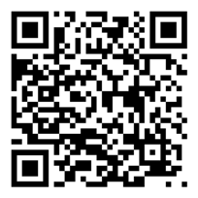
Digital tools & technologies to fast-track delivery, commercialization and scale of biofortified products
Jenny Walton – September 2022
Notes:
Hello I am Jenny Walton, and I will explain the vision, strategy and executional plan we have at Harvestplus on digital tools and technologies for commercialization and scale.

Slide 2

HarvestPlus is committed to the investigation, adoption and research of new technology and digital tools that enable scale in the use & reach of nutrient enriched crops
“Digital technologies, with their rapid development and deployment, can overcome long-standing market and policy failures and accelerate food system transformation if an enabling environment and complementary investments are put in place.” The World Bank. What's Cooking : Digital Transformation of the Agrifood System
Notes:
We started this work in 2018, before covid, where most of this was conceptual and meetings and conversations with high energy, innovative tech start-ups – Covid forced us to act quickly as we could no longer reached our beneficiaries as easily – we had to deliver our program in a non-contact environment and I’m proud and happy to say we did it.

Slide 3


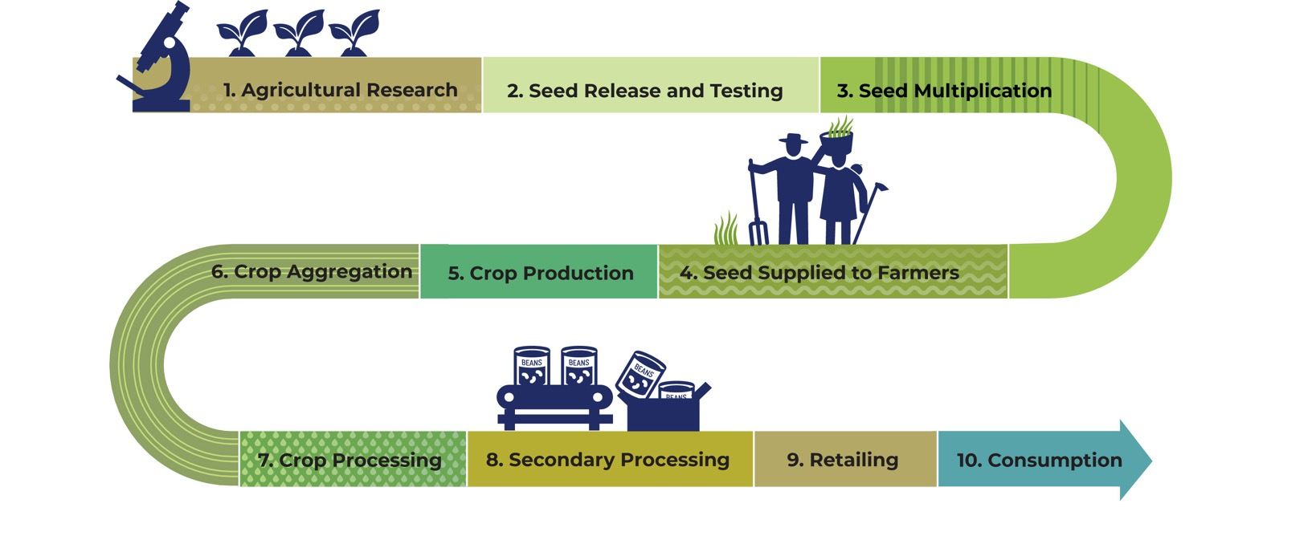


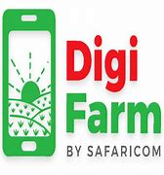


Digital transformation of the supply chain & enabling environment
Predictive modelling
Traceability
Standards
Enabling environment tools
Marketing & Promotions – B2B & B2C
Seed, grain and food analysis
M&E
Live Data collection
Tools for each step in the chain and tools that keep the chain together
Notes:
What we are looking at here is digital transformation of staple food supply chains – we need digital tools to scale as much as our beneficiaries need digital technologies to prosper, and not be left behind.
What we need is a Digital transformation of the supply chain AND enabling environment not just farming and primary production
From the very beggining we are working on Predictive modeling – what we hope will be a revolution for the biofortification priority index which will enable governments, donors and policy makers to make timely and specific actions that could avert crises, influence policy and government investments in tackling malnutrition
Seed production and digitation of seed production and sales, to monitor market changes, make predictions on yield, support businesses to be efficient and globally competitive and also create the foundation for the traceability system
For farming – we know that digital extension can improve productivity and yield – for wheat crops anywhere between 10 and 25% has been reported and even with our own experience’s farmers in receipt of digital extension have reported increases in income – this is because of improved access to better seeds, training - we will hear from PXD about one of the HarvestPlus experiences to date – we will invest in digital extension in all of our delivery programs going forward
Digital platforms for farmers, with partners such as Cropin, eprod and BiofrortX will enable farmers to have access to inputs and markets
We need new ideas on data collection for production and remote sensing could replace farmer surveys and provide more accurate data
Aggregation can also be digitized in terms of monitoring offtake volumes but also connecting the marketplace through digital marketplaces
When it comes to food production, we can support businesses with digital quality management systems and traceability systems that will reduce the risk of food safety incidents and create efficiencies and higher quality products and also prepare the food industry for forthcoming regulations where traceability systems are mandatory
For retailing and marketing – Digital communication plans are more cost effective but also more effective – reaching consumers with awareness campaigns and product promotional messages
Once we have a traceable supplychain we can certify that businesses are using genuine biofortified goods with a logo to signpost to consumers a better product to buy for their families
Not to mention the possibilities with data that feed back into the predictive model – but I will come back to data shortly

Slide 4


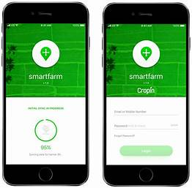
Demand generation: Digital marketing
BUY ZINC WHEAT SEEDS
Collect 1 ton of maize
Notes:
I wanted to highlight 2 digital opportunities here as they are not covered by the guests we have today and the first on Digital marketing and demand creation – we talk about demand creation but for biofortification we have to be more specific as there are so many steps to ignite demand it is not one big exercise – what we have learned is that we need a bespoke and individual value propositions for everyone in the value chain. Specialist agency partners who work with the target audience and media preferences
We create demand for seeds from farmers
We create demand for grain or crops from the aggregators
We create demand from food processors
We create demand from consumers & provide training and awareness on the dangers of malnutrition – 2 very separate activities
We will do this in a digital format going forward – even farm radio is going digital
The cost of reach is cents – across multiple platforms – even tick tok
Remember that HarvestPlus has access to nearly 70 million consumers and farming household we can use that reach more efficiently and cross functionally with other interventions

Slide 5
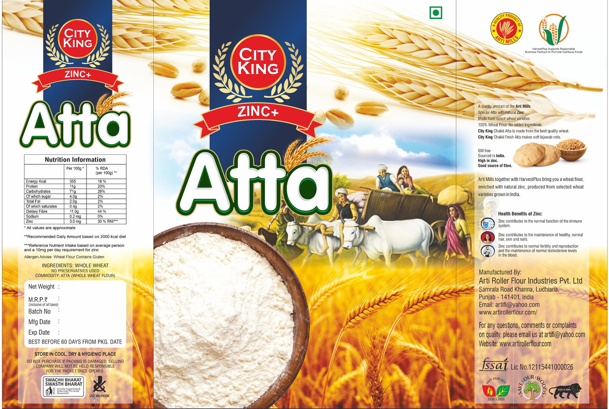

Traceability – standards & certification
Notes:
Moving on to traceability – When we started our scaling and commercialization strategy in earnest 5 years ago, research with 250 businesses highlighted the major barriers to scale
Lack of clear value proposition – using stakeholder research and expertise in market, consumer and business research we discovered and documented the value for all of our stakeholders.
We found issues and gaps with standards in the value chain so we identified the current regulations, filled gaps with commercial standards and we train and equip procurers – until we fixed the regulatory issue we couldn’t tackle the final hurdle is traceability.
Traceability is a critical tool for everyone in the chain – the end consumers so they know where and when their food came from BUT for businesses it essential, they track their inputs and outputs to avoid food safety risks, minimize incidents, ensure high quality, and efficiencies in production – it can also help with product pricing and cost saving initiatives when businesses have an accurate handle on what is coming in and what is going out of their businesses.
SMEs need traceability as it becomes a legal requirement but the better way to work with businesses is showing the rewards of traceability, not the risks of NOT having it
Large businesses, in private sectors but also food procurement such as school feeding or world food program – a consistent, high volume, high quality and traceability supply is essential
The thing about traceability is that many of the countries and value chains we are working in there is ZERO traceability, not even a paper record – maybe relying on someone’s memory of where they bought seeds or who they sold the off take to – we have a job to do to train businesses about the value and important of traceability and go directly to a digital process – we will leapfrog the paper phase
So many opportunities
Block chain – we have partners on standby, especially Nigeria where we can see a route through for low cost data. We are now working with Food Portal, a simple yet very powerful tool which is easy to use and there are many others out there in the countries where we operate.

Slide 6
Data – Possibilities to make an impact
Notes:
Data – the possibilities here are exciting – We are working towards collection of live data through the digital systems and platforms – imagine if we could track seed sales, growth rates, grain trade and food sales on a daily basis
building on our giant repository of data, the live data we collect in in future will be ploughed into cloud based information repositories that can then predict the future, predict the impact, predict the impact of food shocks or crisis – assist donors, governments and policy makers where to direct their investments
Digitization is not just about farmer platforms

Slide 7
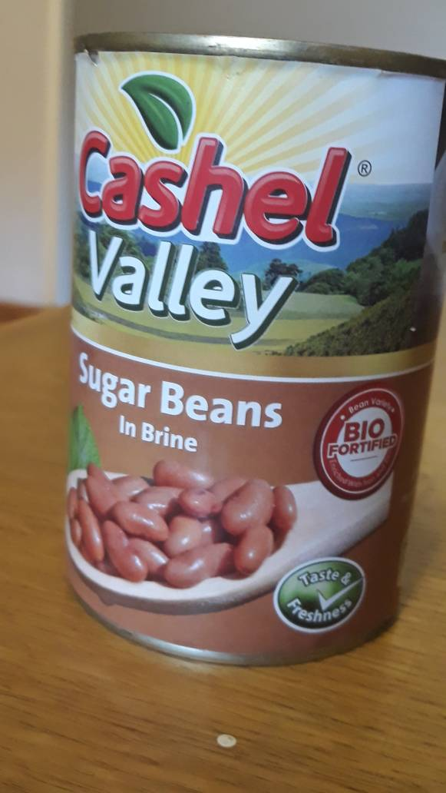
Risk mitigation
Risk | Mitigation
Digital divide | Target beneficiaries of the HarvestPlus program are those most at risk of digital exclusion
Sustainability | Ensure there is a demonstrable return on investment that the user sees so they will make their own digital investments in the future
Data governance | In-house expertise, establish local laws, protect our beneficiaries, train staff and protect the data
Competition | Ensure the best prices from our partners, work with multiple partners and ensure the users know their options
Costs V’s benefits | Establish the theory of change and the impact pathway. Establish data driven return on investment – for users and sponsors
Notes:
Risk mitigation
The biggest risk is the digital divide but we are in the unique position to bridge that divide as our primary beneficiaries are the low income, rural populations – women will be targeted as a priority as we know in many countries, particularly Pakistan women are less likely to have a mobile phone or use the internet
Sustainability – someone has to pay and we are establishing mechanism where users / farmers pay for their own access through increased products – digital extension can be funded by the private sector input companies and food producers will market their own affordable, nutritious foods – we are just the catalyst
Data governance = we will learn the country laws and train our people and employ more experts to ensure we are doing the right thing - we will ensure the users can opt in or out as they want to and protect their data
Competition – we have brought some of our closest partners here today where we are working together but we are not exclusive, we search the markets and work through competitive open procurement and ensure the users / beneficiaries have options – our partners know this and work hard to offer the best prices

Slide 8
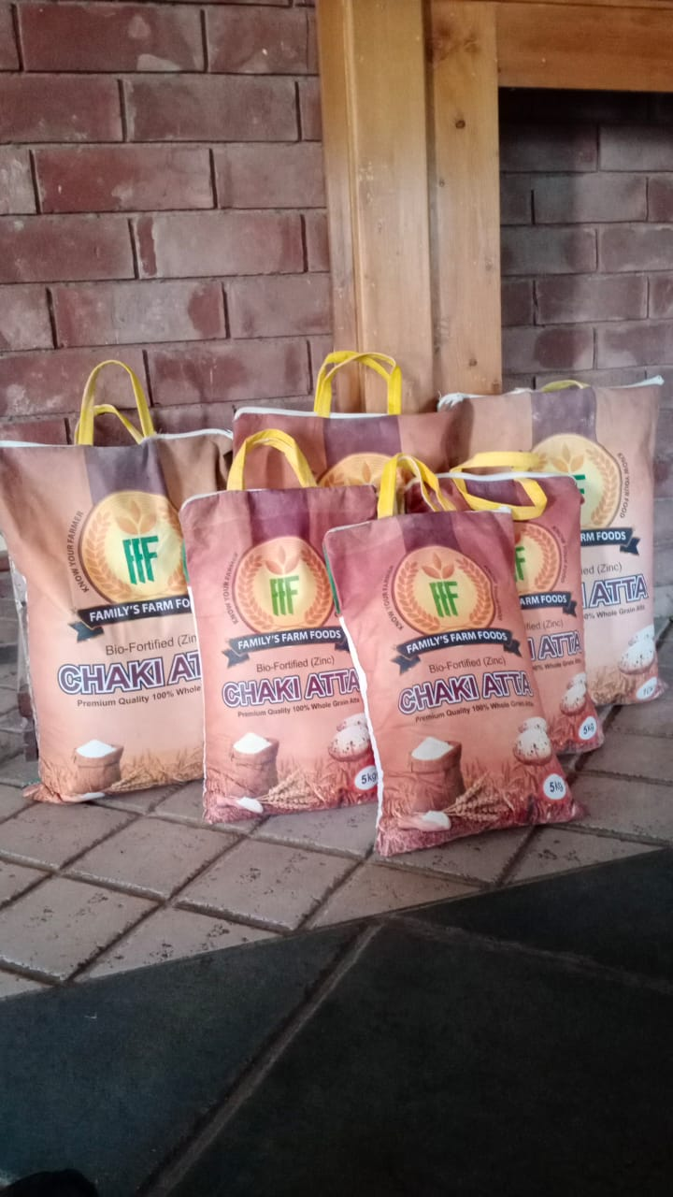
Digital transformation of staple food supply chains for economic growth, food and nutrition security
Digitization is integral to our delivery model and scaling strategy
Continuously plan and work with the best partners
Use our current reach, 70 million people, to bridge the digital divide
Unchartered territory, take calculated risks and be prepared to fail – report our learnings
Notes:
0.5
Summary and conclusions – to summarize – we have a wide range of digital implementation projects in most of our countries and delivery plans. We have concepts, proposals, ideas and budgets for many more – this is the future for HarvestPlus –
With a current reach of 70 million, lower income consumers, we will use our reach power to ensure the digital divide is closed
We will tell our story and we will report results – successes and no doubt failures a long the way – this is a calculated risk
Digitization is a critical tool to reach 1 billion consumers by 2030 and our beneficiaries need digital support – it’s a win win win situation

Slide 9
