Slide 1
Technology:
A Force Multiplier
-Ravinder Grover

Slide 2
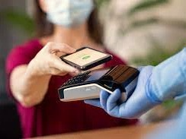
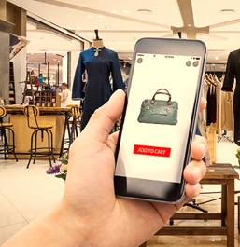
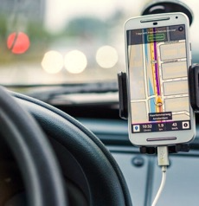
Technology has changed the way we do things
Learn
Pay Bills
Heal
Do Business
Communicate
Entertain
Travel

Slide 3
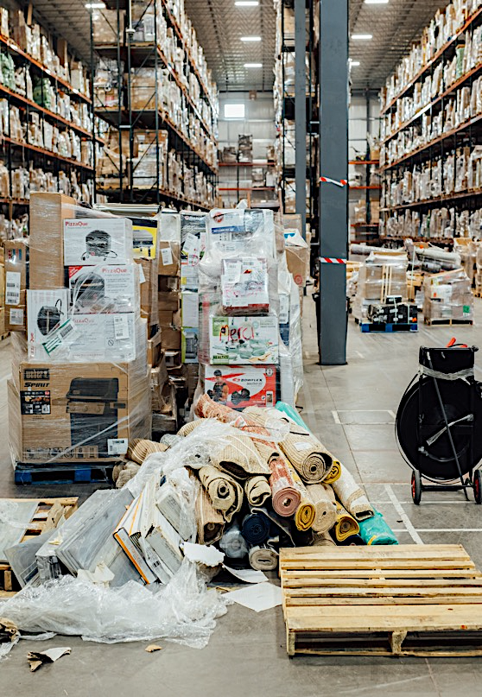
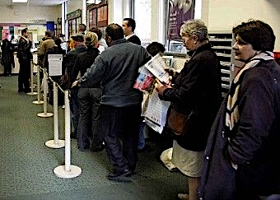
And has disrupted the commercial landscape
Manufacturing
Retail
Mass Customization in Apparels, Electronics etc.
Smart Inventory System
Health
Banking
AR & VR Technologies for Surgical Training
Everything on a Tap

Slide 4
Agriculture is catching up fast
According to McKinsey, if connectivity is implemented successfully in agriculture, the industry could tack on $500 billion in additional value to the global gross domestic product by 2030

Slide 5
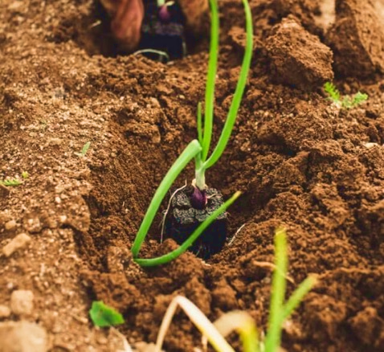
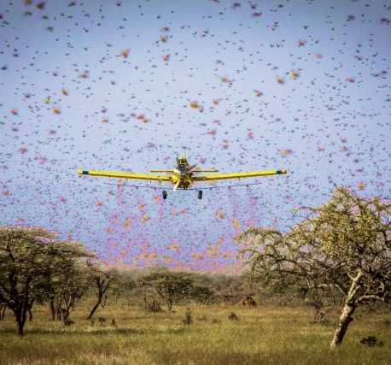
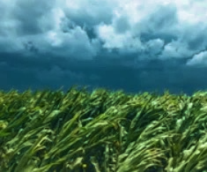
What is going on across the Globe?
India
Kenya
Mexico
Saving Soil
Google collaborates with nurture.farm to identify scalable and cost-effective soil health measurement solutions.
Race to outsmart Locusts
Palm-sized GPS device let field officers record locust encounters then information distributed to countries through LocustHub. Drones used in remote areas.
Short Corn is Smart Corn
By combining data analytics and hybrid breeding processes, short-stature corn was developed to stand at the ideal height to pair perfectly with harvest combine and prevent food loss.

Slide 6
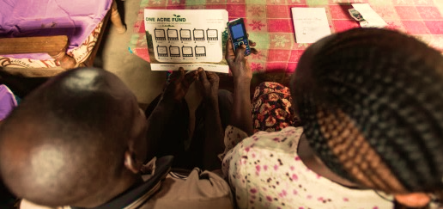
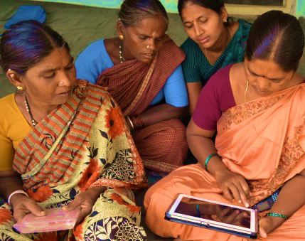
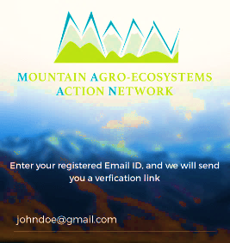
What is going on across the Globe?
Kenya
India
Ethiopia
Finding the best fit
Field agents enrolling farmers and collecting data through tablets, increasing efficiency and scale. Loan repayments facilitated through mobile for farmers, bringing sustainability
Digitizing The Science Of Discovery And The Science Of Delivery
Intelligent Agricultural Systems Advisory Tool (ISAT) deliver SMS
LeasyScan measure leaf surface area and water stress
HarvestMaster records grain weight and moisture
Building a Community
An education based interactive & multilingual app for areas crippled from low network conditions. People coming together for bettering the nutritional condition in the mountain region.

Slide 7
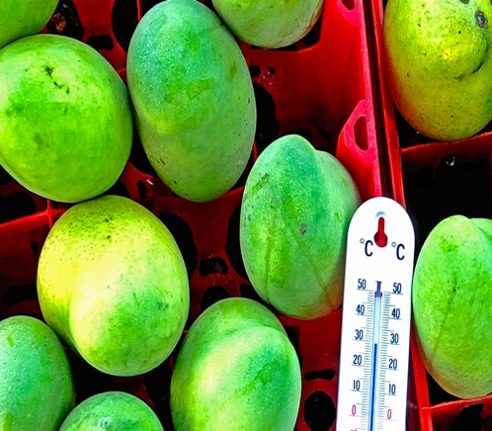
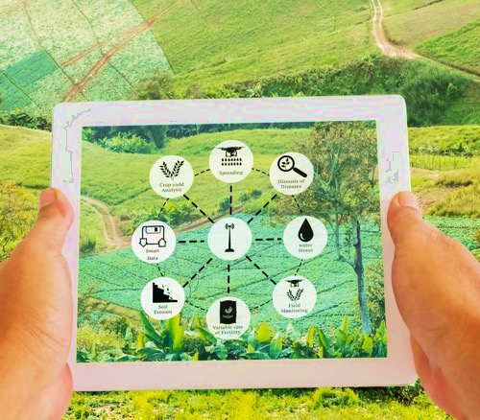
What is going on across the Globe?
Haiti
India
Senegal
Accessing high quality market
The proposed solution uses a third-party cold logistics service provider to reduce spoilage, and a broker, equipped with distributed ledger technology, to connect Haitian farmers with buyers in the United States and Canada.
E-NAM (National Agriculture Market)
A pan-India electronic trading portal which networks the existing APMC mandis to create a unified national market for agricultural commodities. It provides better price discovery through transparent auction process.
Pioneering index-based insurance program
The compensation payment is linked to an index often correlated to climatic data (i.e.: humidity, rainfall, and temperature) generally collected by satellite images or meteorological stations.

Slide 8
Future of Food: Harnessing Technologies to Improve Food Systems
Digitizing aggregation centers providing transparency in price and inventory
Hyperspectral image analysis to measure soil organic carbon, democratize access
Digital trackers providing incentives for healthy eating
Production
Retailing
Inputs
Aggregation
Consumption
Precision farming, pest & disease farming, extension
Farm to market
traceability
Data Collection (Mobile surveys, sensors, Satellite imagery)
Information Exchange (Video, Mobile-voice, text, IVR, Radio/TV) Nudging consumers towards healthier choice

Slide 9
Thank you!

